Slide 1
The lovable city and how we get there
Niki Harre
School of Psychology
University of Auckland

Slide 2
Thanks to
Sin Yin Khoo
Jolisa Gracewood
Greg Wood

Slide 3
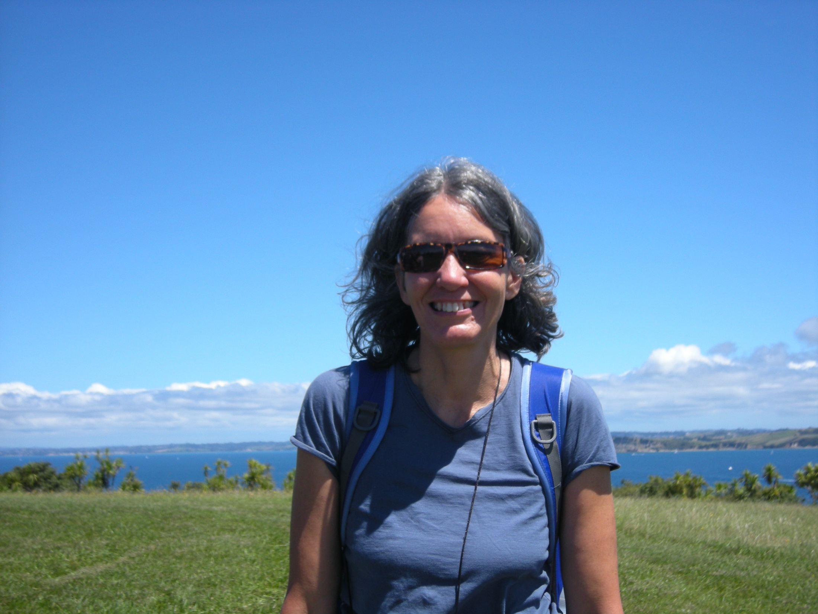
How I spent Waitangi Day

Slide 6
Examples
Promote lovability
Not so much…
Community Education
Food production in the city (e.g. community gardens)
Small-scale art and theatre
Local businesses
School zones
Walking FIRST, cycling SECOND, buses/trains THIRD, cars FOURTH
A city for citizens
Expanding population – did we ever agree to this vision?
Large multi-site businesses
Expensive international shows
A buzzing inner city space that is created by few at the expense of smaller scale centres which people can contribute to
Long hours in work that is not of one’s heart and place
A city for tourists

